Slide 1
Introduction to network Reconnaissance and Scanning
Fundamentals

Slide 2

IP Addresses: Internet's Unique IDs
How Computers Find Each Other
What's an IP Address?: Think of an IP address as your home's street address, but for your computer or phone on the internet. It's a special number that helps devices find and talk to each other online.
Two Main Types: There are two kinds of IP addresses. IPv4 is like a regular phone number (e.g., 192.168.1.1), and IPv6 is a much longer one (e.g., 2001:0db8:85a3:0000:0000:8a2e:0370:7334) for even more devices.
Why It Matters: Just like mail needs your home address to reach you, data on the internet uses IP addresses to find the right computer or phone.
Changing vs. Permanent: Some IP addresses change every time you go online (dynamic), and some stay the same (static), like having a permanent phone number for important stuff.
‎

Slide 3
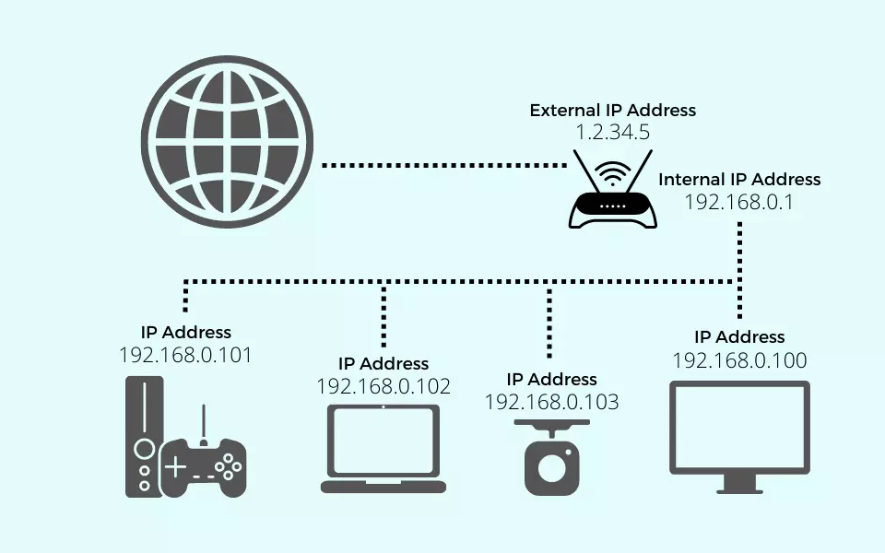
External vs. Internal IP Addresses
Understanding Network Identity
External IP Addresses: An external IP address, also known as a public IP, is assigned to your network by your Internet Service Provider (ISP). It's used to identify your home or business network on the wider internet. Think of it as the address of your building in a city.
Internal IP Addresses: Internal IP addresses, or private IPs, are used inside your network. They are assigned to individual devices (like computers, phones, printers) by your router. These addresses are like apartment numbers within your building, allowing devices to communicate with each other and the router.
Why They Matter: Understanding the distinction is crucial for networking, troubleshooting, and security. External IPs connect you to the world, while internal IPs ensure communication within your network.
‎

Slide 4
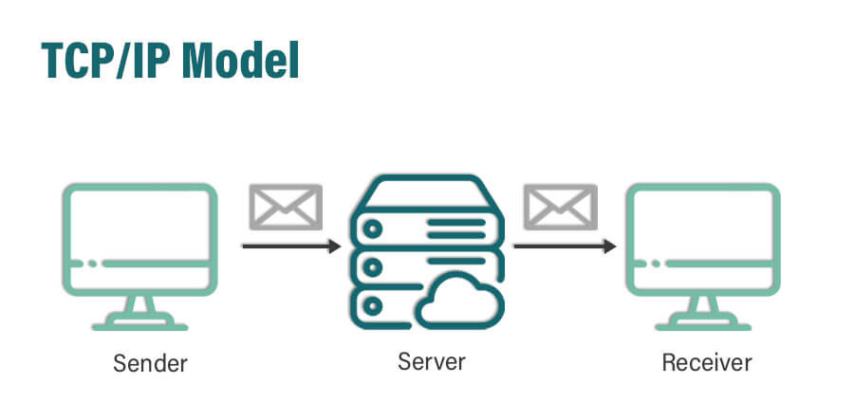
Understanding TCP/IP
The Basics of Internet Communication
What is TCP/IP?: TCP/IP stands for Transmission Control Protocol/Internet Protocol. It's like the postal service of the internet, helping computers send and receive messages.
How Does It Work?: Imagine the internet as a highway, and TCP/IP as the rules of the road. It guides data on how to travel from one computer to another, ensuring it arrives correctly.
Why Is It Important?: Without TCP/IP, the internet wouldn't work! It's essential for web browsing, emailing, and all online activities, making sure data gets where it needs to go.
‎

Slide 5





Nmap: The Network Explorer
Discovering Hosts on a Network
What is Nmap?:
Nmap is like a digital detective. It helps find out which computers are on a network and what they're doing.
How Nmap Helps:
Just as a flashlight helps you see in the dark, Nmap helps us 'see' which devices are connected to a network, what services they offer, and if they have any open 'doors' (ports) that should be closed for safety.
Why Use Nmap?:
Nmap is used by network professionals to keep networks healthy and secure. It's a bit like a health check-up for your network, spotting potential issues before they become big problems.
‎

Slide 6
Nmap Flags Made Easy
Simplifying Flags
-sV: Finding Software/Service Versions: Think of '-sV' like asking devices, 'What version are you?' It helps figure out what software the network devices are running.
-sn: Quick Network Check: Using '-sn' is like playing peek-a-boo with computers. It quickly checks who's there without going into much detail.
-O: Guessing the Operating System: The '-O' flag is like being a detective, trying to guess what kind of system (Windows, Mac, Linux) each computer is using based on clues.
-Pn: Assume Everyone's Home: '-Pn' skips the doorbell and assumes every device on the network is awake and ready to talk, even if they usually don't respond to a hello.
-p: Focusing on Specific Spots: The '-p' lets you pick specific doors (ports) to knock on, whether it's just one, a few, or a whole range, to see if they'll open.
‎

Slide 7
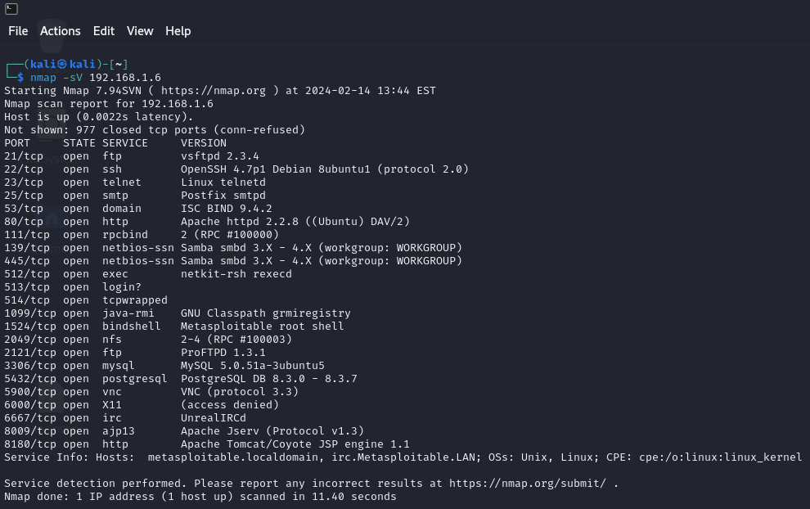
CLI Example
Breaking Down the command
Nmap: This is to run Nmap.
-sV: This option tells Nmap to identify the versions of the services running on the target device.
192.168.2.107: This is the IP address of the device you're scanning. It's the target for the scan.

Slide 8
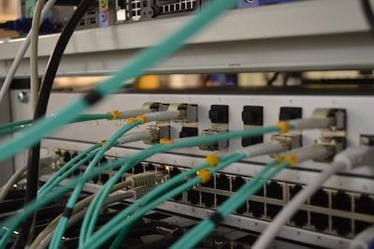
Ping Sweep Explained
A Simple Way to Find Active Computers
What is a Ping Sweep?: Imagine playing 'Marco Polo' in a pool, but with computers. You call out 'Marco' (send a ping), and any computer that's 'it' responds with 'Polo' (a reply), letting you know it's there.
Using Ping Sweep: Network admins use ping sweeps to quickly check which computers are 'awake' and connected to the network. It's like taking attendance in a classroom to see who's present.
Why It's Handy: Ping sweeps help discover other computers on the network and make sure only the right computers are on the network, similar to how a teacher checks for students. It's a basic but effective way to keep the network organized and secure.
‎

Slide 9
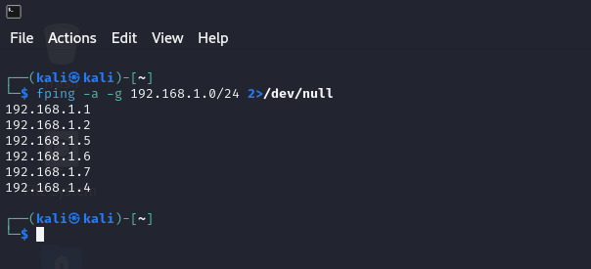
CLI Example
Breaking Down the command
fping: This is to run fping which sends ICMP echo probes to network hosts
-a: This option tells fping to show only the targets that are alive (reachable)
-g 192.168.1.0/2: This option specifies a range of IP addresses to scan
2>/dev/null: means any error messages produced by the command will be discarded and not displayed to the user.

Slide 10

Common Network Services Explained
From FTP to HTTPS
FTP: File Transfers: FTP (File Transfer Protocol) is like a courier service, moving files between computers over the internet.
SMB: Sharing Files in Windows: SMB (Server Message Block) is like a communal library for Windows computers, letting them share files and printers.
SSH: Secure Remote Control: SSH (Secure Shell) is like a secure line for remote control, letting you safely command another computer over the internet.
NFS: Sharing Files in Unix/Linux: NFS (Network File System) is like SMB but for Unix/Linux, creating a shared space for files across those systems.
RDP: Remote Windows Desktop: RDP (Remote Desktop Protocol) lets you use a Windows computer from anywhere, like having a remote control for your PC.
VNC: Universal Remote Desktop: VNC (Virtual Network Computing) is a universal remote control for computers, letting you see and interact with a desktop from anywhere.
HTTP/HTTPS: Web Browsing: HTTP and HTTPS are the roads and secure tunnels of the internet, carrying your web browsing from your computer to websites and back.
‎

Slide 11

Common Vulnerabilities in Network Services
Identifying and Understanding Risks
VSFTPD 2.3.4 Vulnerability: This version of the FTP server has a backdoor, like leaving a secret entrance unlocked, potentially allowing unauthorized access.
SMB: EternalBlue: EternalBlue exploits older Windows systems' SMB protocol, similar to a master key that can unlock many doors, leading to the spread of malware.
SSH 4.7 Brute Forcing: SSH version 4.7 is susceptible to brute force attacks, akin to someone guessing your password over and over until they get it right.

Slide 12

Understanding Metasploit, CVEs, and PoCs
Key Concepts in Cybersecurity
Metasploit Framework: Metasploit is a powerful tool for developing and executing exploit code against a remote target machine. It's widely used for penetration testing, vulnerability testing, and developing security awareness.
Common Vulnerabilities and Exposures (CVEs): CVEs are publicly disclosed cybersecurity vulnerabilities and exposures. Each CVE is identified by a unique number, providing a standardized reference for identifying and addressing vulnerabilities.
Proof of Concept (PoC): A PoC in cybersecurity is a demonstration to prove that a vulnerability or attack vector is exploitable. It's a practical verification showing the potential impact of a vulnerability without causing harm.
‎

Slide 13
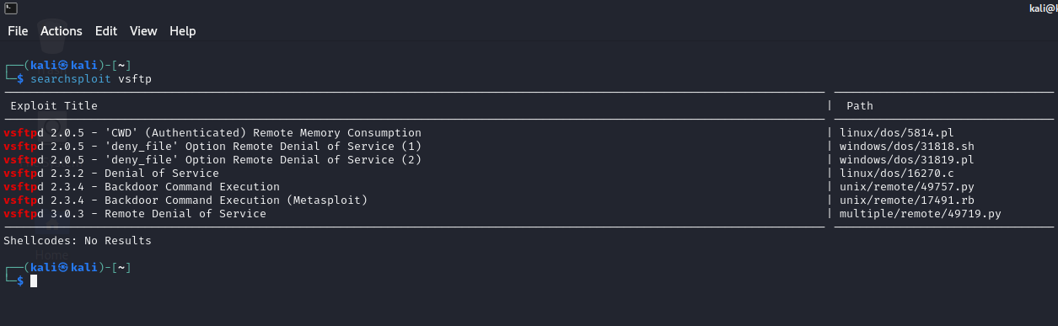
Searching for a vulnerability
Using Searchsploit database
Searchsploit is a command-line search tool for the Exploit Database (exploit-db.com), which is a widely-used archive of security exploits and vulnerabilities. It allows users to quickly search for known exploits, security vulnerabilities, and related information based on keywords or specific criteria.

Slide 14
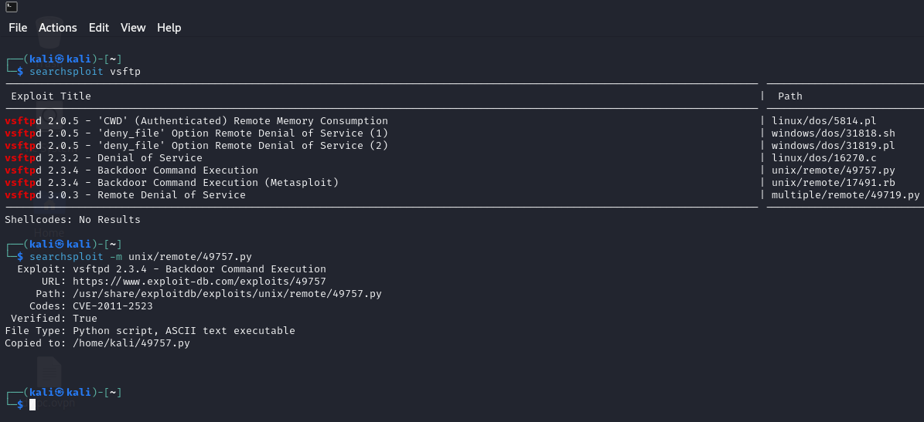
Download proof of concept (PoC)
Using Searchsploit database
Searchsplot vsftp
This will list all related exploits and PoCs available in the database.
Searchsploit –m unix/remote/49757.py
This command will download 49757.py script in your current directory.

Slide 15
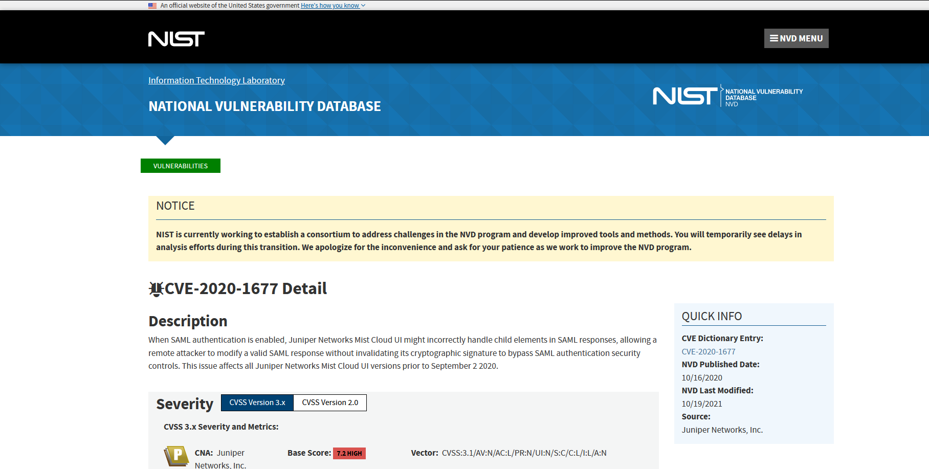
Searching for a vulnerability
Using NIST database
NVD stands for National Vulnerability Database, and it is maintained by the National Institute of Standards and Technology (NIST) of the United States.
NVD collects vulnerability information from various sources, including vendors, security researchers, and public disclosures. It standardizes and provides structured information about vulnerabilities, including descriptions, severity ratings

Slide 16

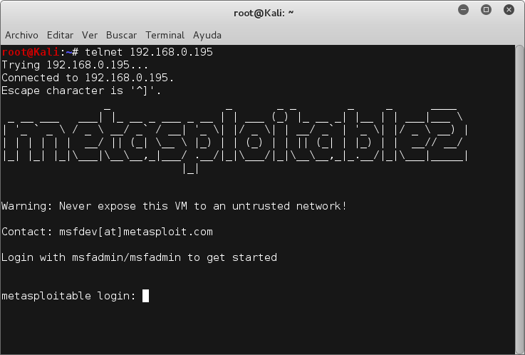
What is Metasploitable 2
Metasploitable is a purposely vulnerable virtual machine (VM) created for security testing and training purposes. It's designed to simulate a vulnerable Linux-based system with intentionally insecure configurations and software
The goal of Metasploitable is to provide a safe and controlled environment where users can learn and experiment with various security tools, techniques, and methodologies without causing harm to real production systems.

Slide 17
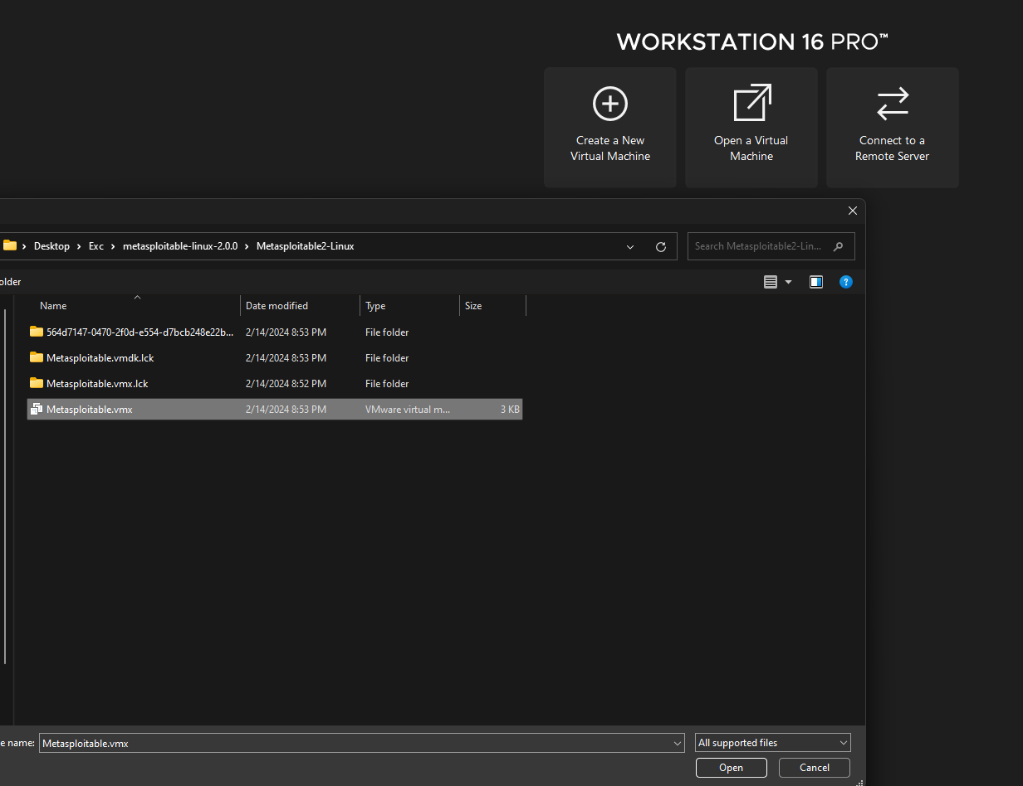
Install Metasploitable 2
Using VMware workstation/player
Download Metasploitable from official website here.
Unzip the .zip file
Open Vmware>open virtual machine>metasploitable.vmx
Password: msfadmin:msfadmin

